Slide 1
18CSC304J COMPILER DESIGN
UNIT 4
SESSION 13

Slide 2
Topics that will be covered
Cross Compiler – T diagrams
Issues in Cross Compilers

Slide 3
CROSS COMPILER

Slide 4
Cross Compiler
A cross compiler is a compiler capable of creating executable code for a platform other than the one on which the compiler is running
For example, a compiler that runs on a Windows 7 PC but generates code that runs on Android smartphone is a cross compiler
A cross compiler is necessary to compiler code for multiple platforms from one development host
Direct compilation on the target platform might be infeasible, for example on a microcontroller of an embedded system, because those systems contain no operating system
In paravirtualization, one computer runs multiple operating systems and a cross compiler could generate an executable for each of them from one main source

Slide 5
Uses of a Cross Compiler
The fundamental use is to separate the build environment from the target environment.
This is useful in several situations:
Embedded computers where a device has extremely limited resources. For example, a microwave oven will have an extremely small computer to read its touchpad and door sensor, provide output to a digital display and speaker and to control the machinery for cooking food. This computer will not be powerful enough to run a compiler, a file system, or a development environment. Cross compilation will be useful here.
Compiling for multiple machines. For example, a company may wish to support several different versions of an operating system or to support several different operating systems. By using a cross compiler, a single build environment can be set up to compile for each of these targets
Compiling on a server farm (collection of computer servers) : A complicated build that involves many compile operations can be executed across
Bootstrapping to a new platform (Bootstrapping is the technique for producing a self-compiling compiler – that is, a compiler written in the source programming language that it intends to compile)
Compiling native code for emulators for older obsolete platforms

Slide 6
GCC and Cross Compilation
GCC, a free software collection of compilers, can be set up to cross compile
It supports many platforms and languages
GCC requires a copy of binutils ( GNU Binary Utilities – a set of programming tools for creating and managing binary programs, object files, libraries, profile data, and assembly source code) be available for each targeted platform
Especially important is the GNU Assembler
Cross-compiling GCC requires that a portion of the target platform’s C standard library be available on the host platform

Slide 7
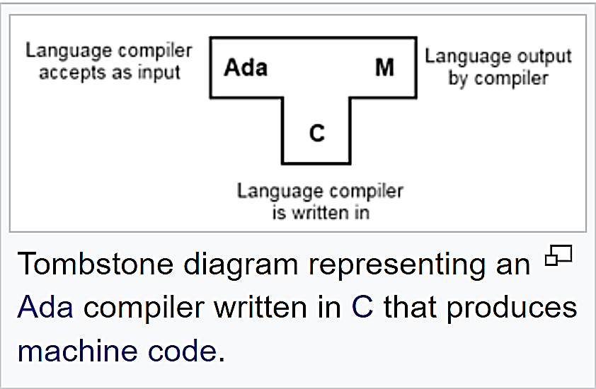
Tombstone diagram (T-diagrams)
In computing, tombstone diagrams consist of a set of puzzle pieces representing compilers and other related language processing programs
They are used to illustrate and reason about transformations from a source language (left of T) to a target language (right of T) realized in am implementation language (bottom of T)
They are most commonly found describing complicated processes for bootstrapping, porting, and self-compiling of compilers, interpreters and macro-processors

Slide 8
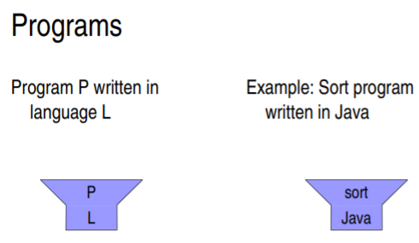
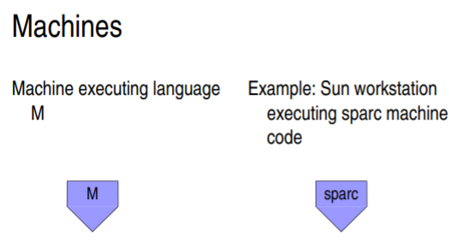
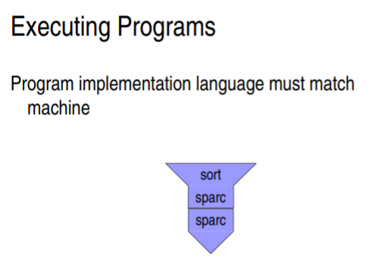
Different Diagrams for different kinds of programs

Slide 9
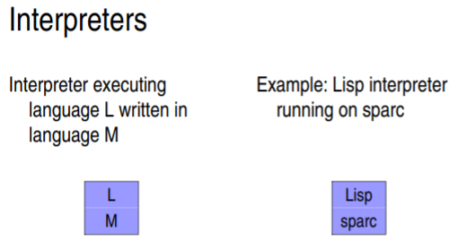
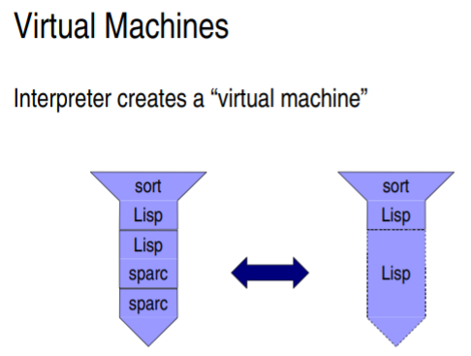
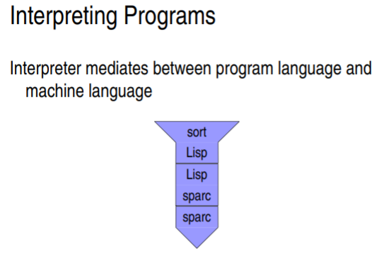
Different Diagrams for different kinds of programs – cont..

Slide 10
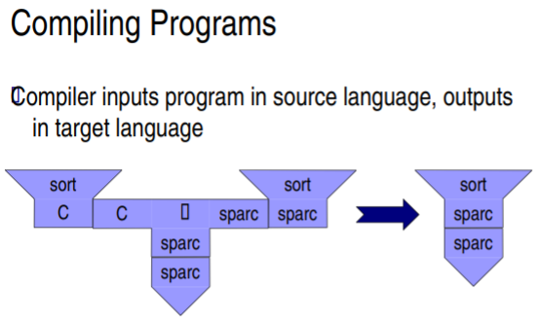
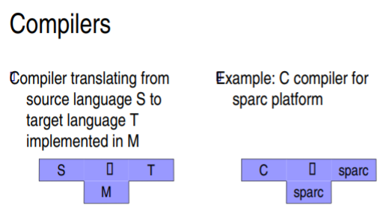
Different Diagrams for different kinds of programs – cont..

Slide 11
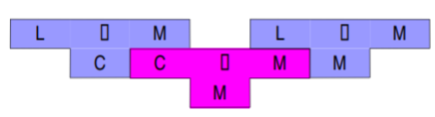

How to write Compilers?
Write it in machine code
Write it in a lower level language and compile it using an existing compiler
Write it in the same language that it compiles and bootstrap

Slide 12
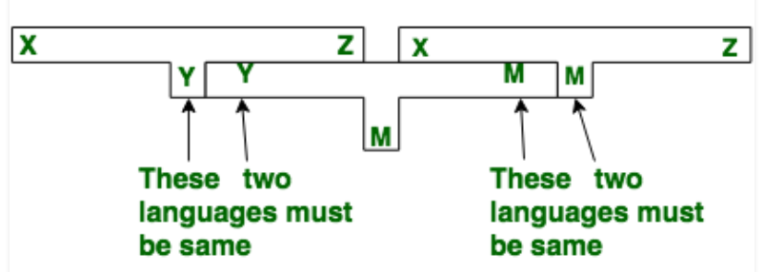
Bootstrapping
Suppose we want to write a cross compiler for new language X
The implementation language of this compiler is say Y and the target code being generated is in language Z
That is, we create XYZ
Now, if existing compiler Y runs on machine M and generates code for M then it is denoted as YMM
Now, if we run XYM using YMM then we get a compiler XMZ, that is, a compiler for source language X that generates a target code in language Z and which runs on machine M

Slide 13
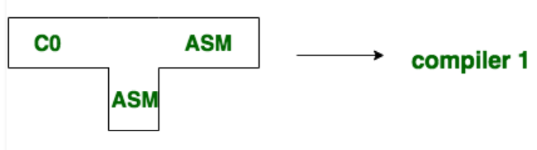
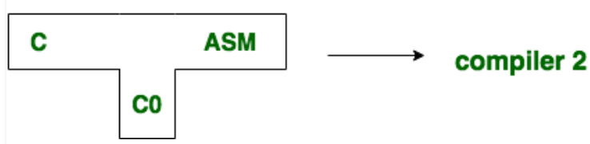
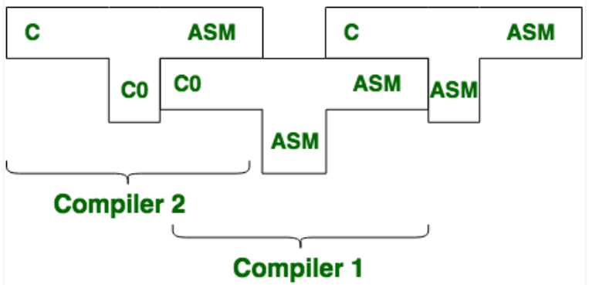
Bootstrapping - Example
Steps to create a compiler which takes C language and generates an assembly language as output with a machine of assembly language
Setp 1 : First write a compiler for a small subset of C in assembly language
Setp 2 : Then using the small subset o fC, ie., C0, the compiler is written for the source language C
Setp 3 : Finally, we compile the second compiler
using compiler 1

Slide 14
ISSUES IN CROSS COMPILERS

Slide 15
Issues in Cross Compilers
Portable native compiling is hard
Most programs are developed on x86 hardware, where they are compiled natively. Most programs make assumptions about the type of machine they run on, which must match the platform in question or the program won’t work. Common assumptions include
Word size
Endianness
Alignment
Default signedness
When the target platform doesn’t have a Memory Management Unit

Slide 16
Issues in Cross Compilers – cont..
Configuring issues – Packages with a separate configuration step runs some configuration tests. When cross compiling, these values differ between the host system and the target system.
HOSTCC vs TARGETCC – Many build processes require compiling things to run on the host system. Simply replacing the host compiler with a target compiler breaks packages that need to build things that run during the build itself.
Toolchain Leaks – An improperly configured cross-compile toolchain may leak bits of the host system into the compiled programs, resulting failures that are usually easy to detect but which can be difficult to diagnose and correct. The toolchain may include the wrong header files, or search the wrong library paths at link time. Shared libraries often depend on other shared libraries which can also sneak in unexpected link-time references to the host system
Libraries – Dynamically linked programs must access the appropriate shared libraries at compile time. Shared libraries to the target system need to be added to the cross-compile toolchain so that programs can link against them
Testing – On native builds, the development system provides a convenient testing environment. When cross-compiling, confirming that “hello world” built successfully can require configuring a bootloader, kernel, root file system, and shared libraries

